Slide 1
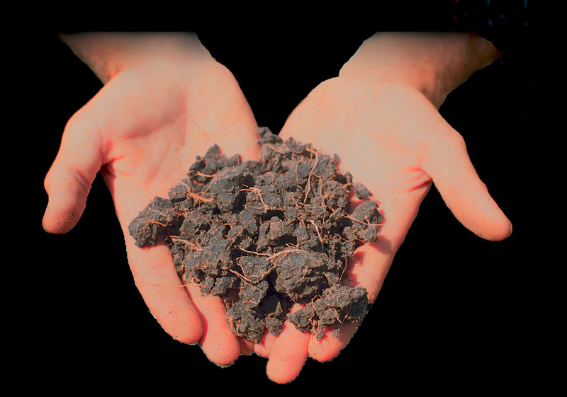
Soils

Slide 2
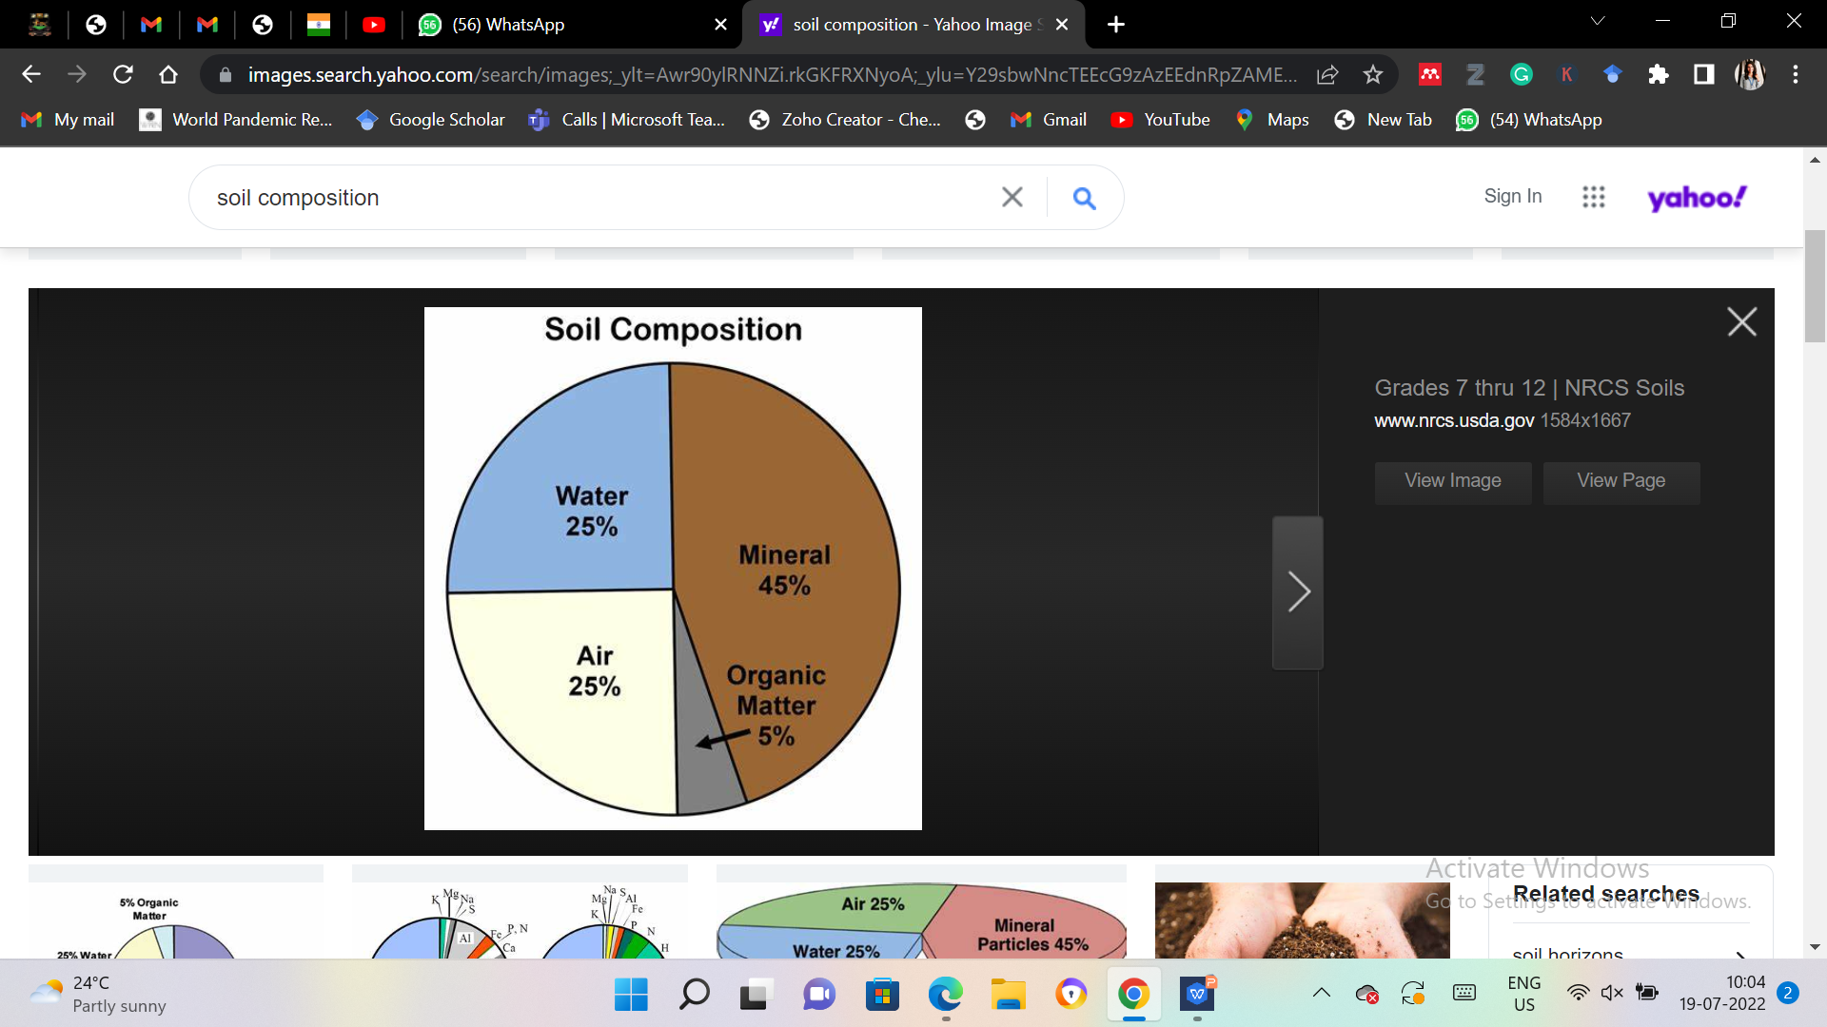
Soil: Definition
Solid earth material that has been altered by physical, chemical and organic processes so that it can support rooted plant life.

Slide 3
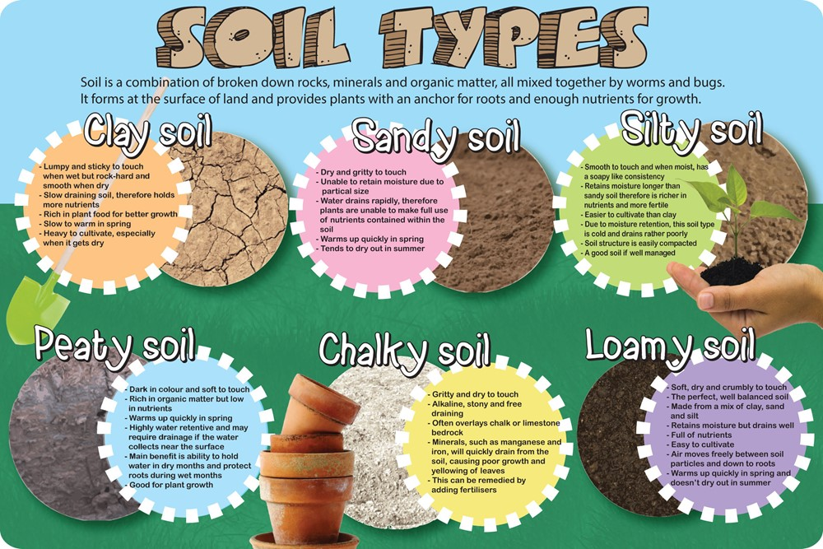

Slide 4
Factors of Soil Formation
Climate
Organisms
Parental Material
Topography
Time

Slide 5
Factors of Soil Formation
Climate
Temperature and precipitation
Indirect controls (e.g., types of plants)
Weathering rates
The greater the rainfall amount, the more rapid the rate of both weathering and erosion.

Slide 6
Factors of Soil Formation
Organisms
Types of native vegetation
Weathering is dependent of plant growth
Plant and animal activity produces humic acids that are powerful weathering agents.
Plants can physically as well as chemically break down rocks.
Plants stabilize soil profiles, Animals (including humans) tend to increase erosion.

Slide 7
Factors of Soil Formation
Topography:
Ground slope
Elevation
Aspect (e.g., north facing vs. south facing slopes)

Slide 8
Factors of Soil Formation
The steeper the surface slope, the more likely any eroded material is to be transported out of the system.

Slide 9
Factors of Soil Formation
Soils on flat surfaces, such as floodplains or plateaus, tend to thicken through time due to weathering rates being greater than sediment transport rates.

Slide 10
Factors of Soil Formation
Time
Development and destruction of soil profiles
Typical reaction rates are slow, the longer a rock unit has been exposed, the more likely it is to be weathered.

Slide 11
Additions to Soils
Inputs from outside ecosystem
Atmospheric inputs
Precipitation, dust, deposition
Horizontal inputs
Floods, tidal exchange, erosion, land-water movement
Inputs from within ecosystem
Litterfall and root turnover

Slide 12
Decomposition
Breakdown of soil organic matter to form soluble compounds that can be absorbed or leached
Depends on
Quantity of input
Location of input (roots vs. leaves)
Environment
Temperature
Moisture

Slide 13
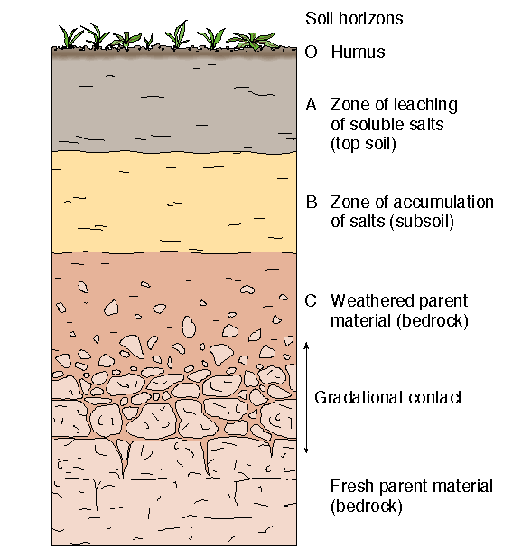
Soil Profiles

